Slide 1



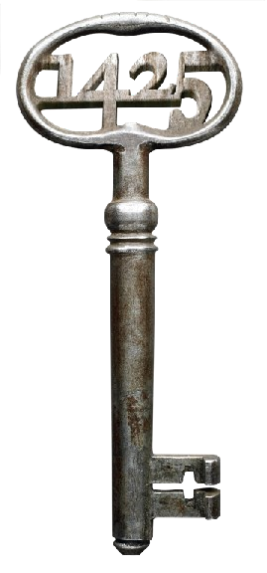
Presented By
Hussain Abbas - r0909805
B-KUL - H0A15A
Virtual Product Development
Submitted to
Prof. Sylvie Castagne
Prof. Bey Vrancken

Slide 2

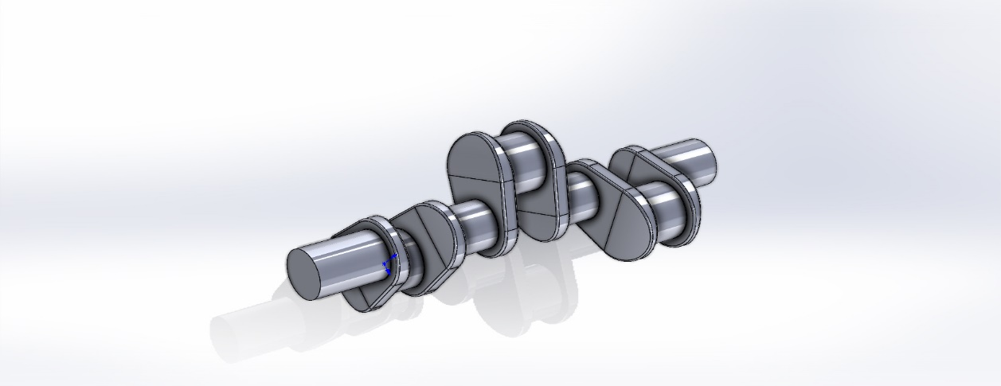
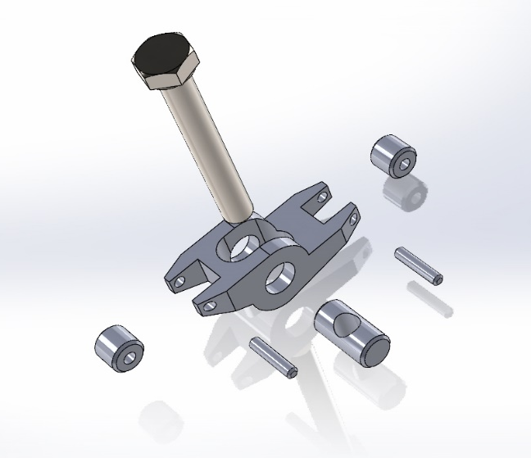
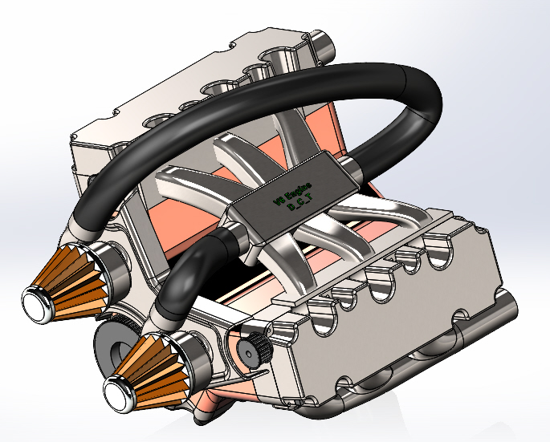
CAD Modelling of V6 Engine
Over 25 parts were manufactured in total, including more than 5 small and large assemblies
Engine Crankshaft
Exhaust Manifold
Areas Touched
Conic Section and Hermite Curves
Bottom up Assembly Technique
Mate with Offset
Feature based modelling
Bilinear Surfaces
Connected-Automated Vehicles
Lower Housing Assembly
Upper Housing Assembly
Rocker Arm Assembly
Piston V6
Final Assembly of V6 Engine

Slide 3
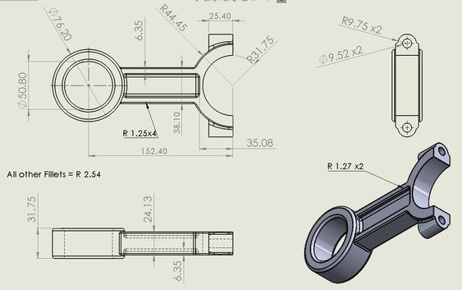
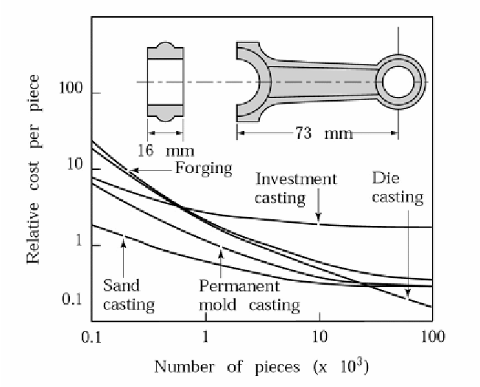
Process Selection
Production No: 10000
Step 1: Since we want to produce 10000 parts and our primary manufacturing process is Solid Forming thus by looking at the Table 5.4 we get that our relative quantity is 10000/2000 =5, thus it is a relative high quantity and we go to Table 5.4.
Step 2: Shape complexity is open type and is long and have thick and thin section
Step 3: Priority 1 is column G14 – Forging
Sand casting:
If we want to create our part using a liquid process, Sand casting is the greatest option, according to what we've learned, because the thickness of our part is in the 3-5mm region, so we can utilize it. Similarly, there are no weight or material constraints, therefore sand casting will be the second alternative.

Slide 4
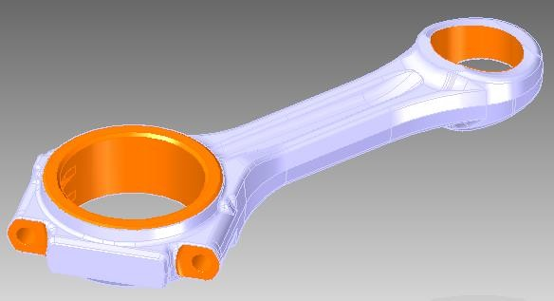
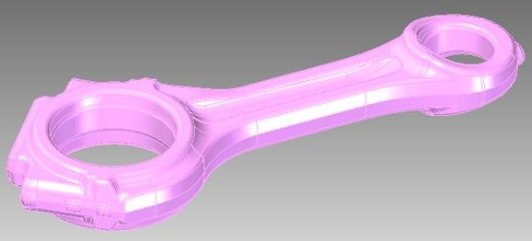
Detailed Processes for Connecting Rod
Order of Processes
(Top – Bottom)
i.) Rough Milling of Faces
ii.) Drilling of holes at Crank end and Pin end
ii.) Rough Boring of Crank end and Pin end
iii.) Fine Milling
iv.) Fine Boring
v.) Drill holes
vi) Threading holes

Slide 5
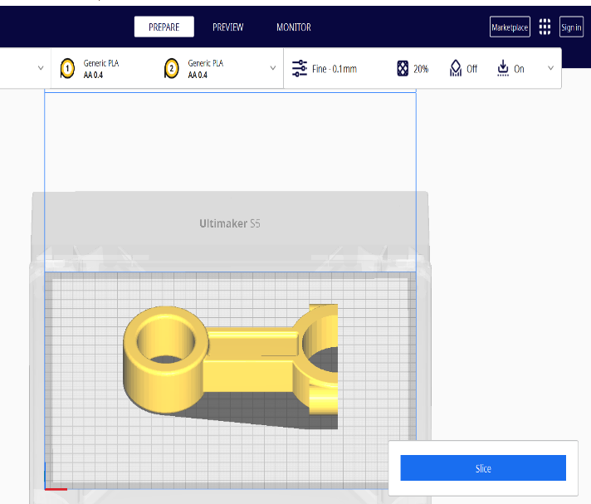
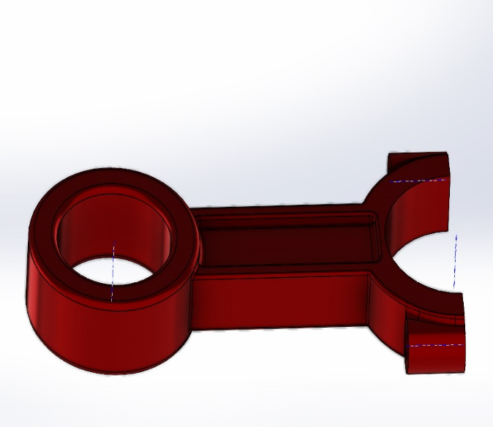
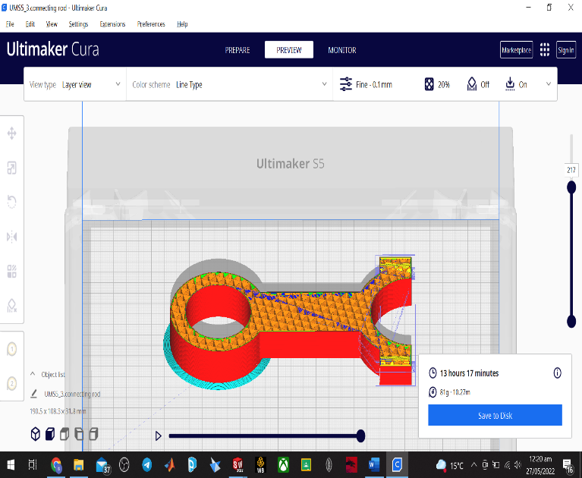
Different Format Analysis
Processor Testing
Formats testing: IGES, STEP, STL
Tests performed: Closed Loop / System Test
Observations
STL files don’t retain color information (UltimakerCURA)
IGES file have loss of data around curvatures
STEP retain information around curvatures
STEP can save other important information such as tolerances, material properties etc

